Slide 1
Testing

Slide 2
Organization of this lecture
Important concepts in program testing
Black-box testing:
  equivalence partitioning
  boundary value analysis
White-box testing
Unit, Integration, and System testing
Summary

Slide 3
Testing
The aim of testing is to identify all defects in a software product.
However, in practice even after thorough testing:
  one cannot guarantee that the software is error-free.

Slide 4
Testing
The input data domain of most software products is very large:
  it is not practical to test the software exhaustively with each input data value.

Slide 5
Testing
Testing does however expose many errors:
  testing provides a practical way of reducing defects in a system
  increases the users' confidence in a developed system.

Slide 6
Testing
Testing is an important development phase:
  requires the maximum effort among all development phases.
In a typical development organization:
  maximum number of software engineers can be found to be engaged in testing activities.

Slide 7
Testing
Many engineers have the wrong impression:
  testing is a secondary activity
  it is intellectually not as stimulating as the other development activities, etc.

Slide 8
Testing
Testing a software product is in fact:
  as much challenging as initial development activities such as specification, design, and coding.
Also, testing involves a lot of creative thinking.

Slide 9
How do you test a program?
Input test data to the program.
Observe the output:
  Check if the program behaved as expected.

Slide 10



How do you test a system?

Slide 11
How do you test a system?
If the program does not behave as expected:
  note the conditions under which it failed.
  later debug and correct.

Slide 12
Basic Concepts and terminologies
Error is a mistake committed by the developer team during any of the development phases.
An error is sometimes referred to as a fault, a bug or a defect.
Error, Faults, and Failures

Slide 13
Basic Concepts and terminologies
A failure is a manifestation of an error (aka defect or bug).
  mere presence of an error may not lead to a failure.
Error, Faults, and Failures

Slide 14
Test cases and Test suites
Basic Concepts and terminologies
A test case is a triplet [I,S,O]
  I is the data to be input to the system,
  S is the state of the system at which the data will be input,
  O is the expected output of the system.

Slide 15
Basic Concepts and terminologies
Test cases and Test suites
Test a software using a set of carefully designed test cases:
  the set of all test cases is called the test suite

Slide 16
Verification versus Validation
Verification is the process of determining:
  whether output of one phase of development conforms to its previous phase.
Validation is the process of determining
  whether a fully developed system conforms to its SRS document.

Slide 17
Verification versus Validation
Aim of Verification:
  phase containment of errors
Aim of validation:
  final product is error free.

Slide 18
Verification versus Validation
Verification:
  are we doing right?
Validation:
  have we done right?

Slide 19
Design of Test Cases
Exhaustive testing of any non-trivial system is impractical:
  input data domain is extremely large.
Design an optimal test suite:
  of reasonable size and
  uncovers as many errors as possible.

Slide 20
Design of Test Cases
If test cases are selected randomly:
  many test cases would not contribute to the significance of the test suite,
  would not detect errors not already being detected by other test cases in the suite.
Number of test cases in a randomly selected test suite:
  not an indication of effectiveness of testing.

Slide 21
Design of Test Cases
Testing a system using a large number of randomly selected test cases:
  does not mean that many errors in the system will be uncovered.
Consider an example for finding the maximum of two integers x and y.

Slide 22
Design of Test Cases
The code has a simple programming error:
If (x>y) max = x;
else max = y;
test suite {(x=3,y=2);(x=2,y=3)} can detect the error,
a larger test suite {(x=3,y=2);(x=4,y=3); (x=5,y=1)} does not detect the error.

Slide 23
Design of Test Cases
Systematic approaches are required to design an optimal test suite:
  each test case in the suite should detect different errors.

Slide 24
Design of Test Cases
There are essentially two main approaches to design test cases:
  Black-box approach
  White-box (or glass-box) approach

Slide 25
Black-box Testing
Test cases are designed using only functional specification of the software:
  without any knowledge of the internal structure of the software.
For this reason, black-box testing is also known as functional testing.

Slide 26
White-box Testing
Designing white-box test cases:
  requires knowledge about the internal structure of software.
  white-box testing is also called structural testing.
  In this unit we will not study white-box testing.

Slide 27
Black-box Testing
There are essentially two main approaches to design black box test cases:
  Equivalence class partitioning
  Boundary value analysis

Slide 28
Equivalence Class Partitioning
Input values to a program are partitioned into equivalence classes.
Partitioning is done such that:
  program behaves in similar ways to every input value belonging to an equivalence class.

Slide 29
Why define equivalence classes?
Test the code with just one representative value from each equivalence class:
  as good as testing using any other values from the equivalence classes.

Slide 30
Equivalence Class Partitioning
How do you determine the equivalence classes?
  examine the input data.
  few general guidelines for determining the equivalence classes can be given

Slide 31
Equivalence Class Partitioning
If the input data to the program is specified by a range of values:
  e.g. numbers between 1 to 5000.
  one valid and two invalid equivalence classes are defined.
1
5000

Slide 32
Equivalence Class Partitioning
If input is an enumerated set of values:
  e.g. {a,b,c}
  one equivalence class for valid input values
  another equivalence class for invalid input values should be defined.

Slide 33
Example
A program reads an input value in the range of 1 and 5000:
  computes the square root of the input number
SQRT

Slide 34
Example (cont.)
There are three equivalence classes:
  the set of negative integers,
  set of integers in the range of 1 and 5000,
  integers larger than 5000.
1
5000

Slide 35
Example (cont.)
The test suite must include:
  representatives from each of the three equivalence classes:
  a possible test suite can be:
  {-5,500,6000}.
5000
1

Slide 36
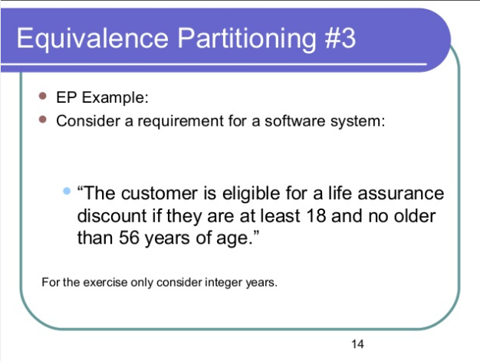


Slide 37
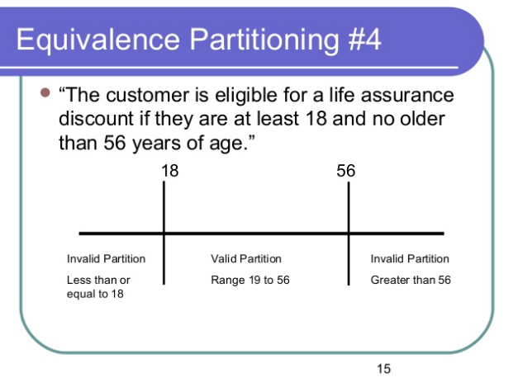

Slide 38
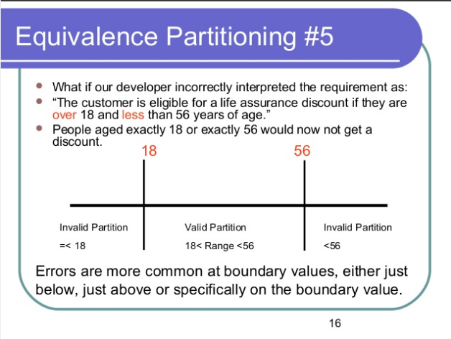

Slide 39
Boundary Value Analysis
Some typical programming errors occur:
  at boundaries of equivalence classes
  might be purely due to psychological factors.
Programmers often fail to see:
  special processing required at the boundaries of equivalence classes.

Slide 40
Boundary Value Analysis
Programmers may improperly use < instead of <=
Boundary value analysis:
  select test cases at the boundaries of different equivalence classes.

Slide 41
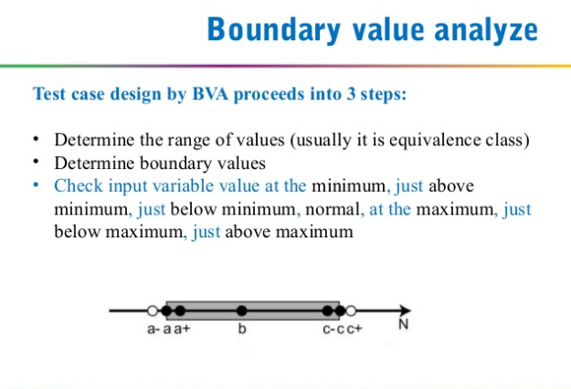

Slide 42
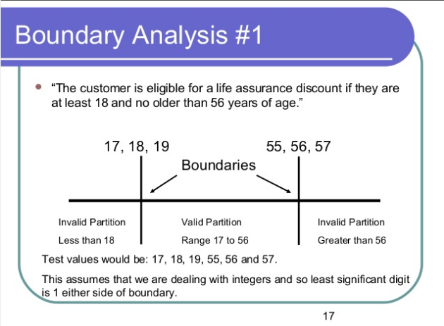

Slide 43
Example
For a function that computes the square root of an integer in the range of 1 and 5000:
  test cases must include the values: {0,1,5000,5001}.
1
5000

Slide 44
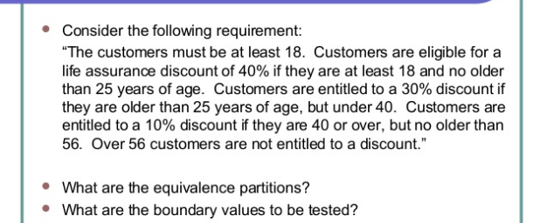

Slide 45
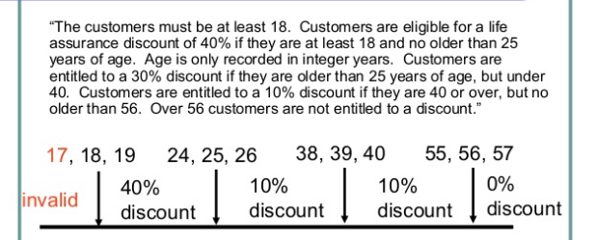

Slide 46
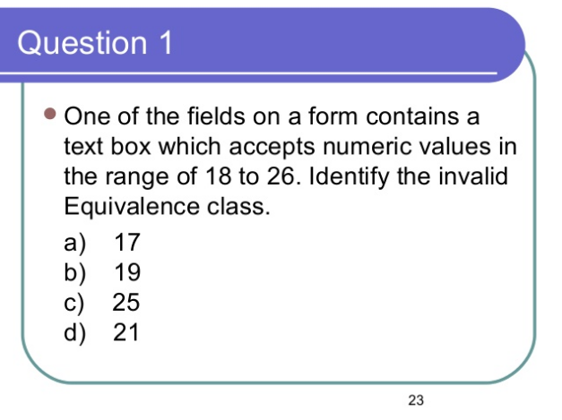

Slide 47
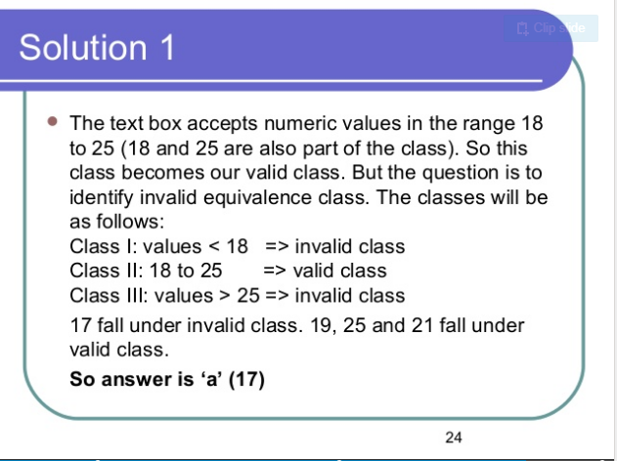

Slide 48
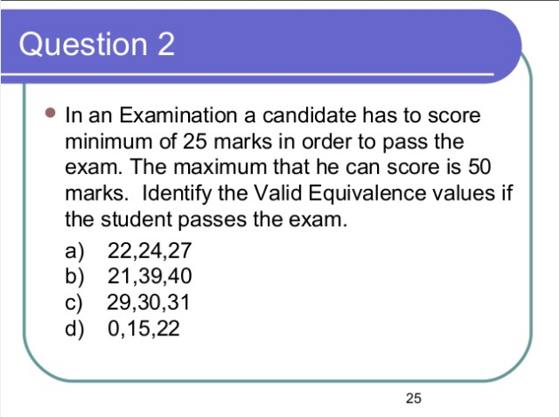

Slide 49
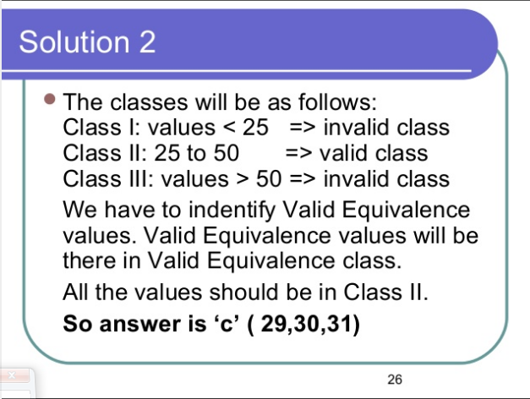

Slide 50
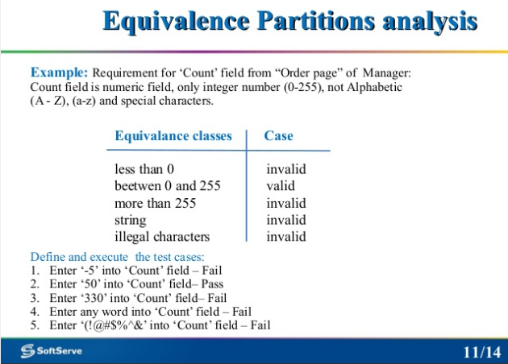

Slide 51
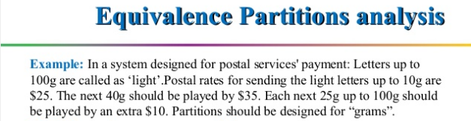
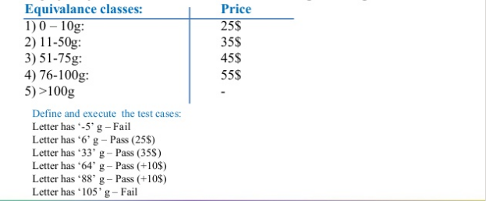

Slide 52
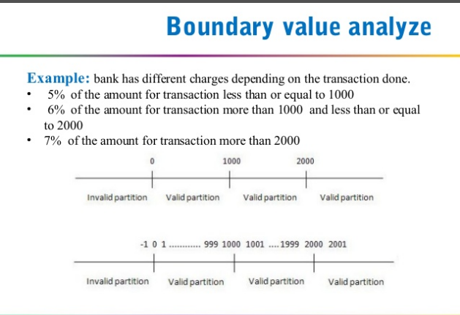

Slide 53
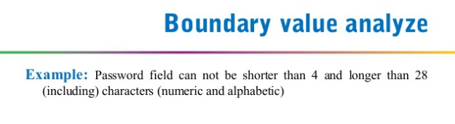

Slide 54
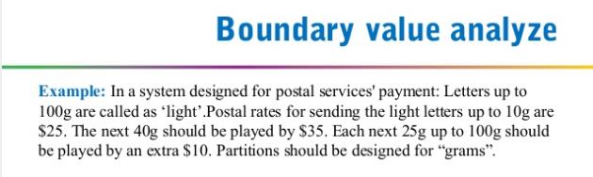
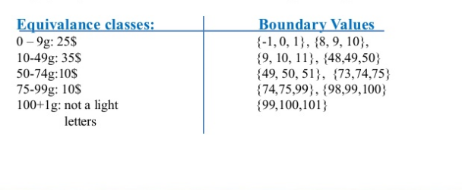

Slide 55
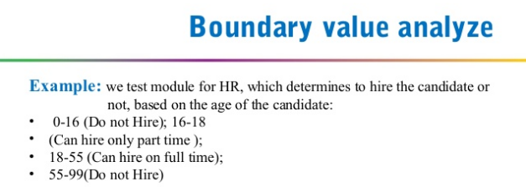
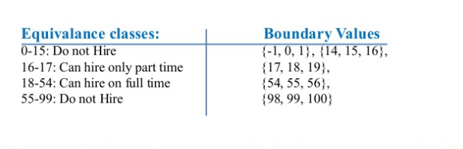

Slide 56
Levels of Testing
Software products are tested at three levels:
  Unit testing
  Integration testing
  System testing

Slide 57
Unit testing
During unit testing, modules are tested in isolation:
  If all modules were to be tested together:
    it may not be easy to determine which module has the error.

Slide 58
Unit testing
Unit testing reduces debugging effort several folds.
  Programmers carry out unit testing immediately after they complete the coding of a module.

Slide 59
Integration testing
After different modules of a system have been coded and unit tested:
  modules are integrated in steps according to an integration plan
  partially integrated system is tested at each integration step.

Slide 60
System Testing
System testing involves:
  validating a fully developed system against its requirements.

Slide 61
Integration Testing
Develop the integration plan by examining the structure chart :
  big bang approach
  top-down approach
  bottom-up approach
  mixed approach

Slide 62
Big bang Integration Testing
Big bang approach is the simplest integration testing approach:
  all the modules are simply put together and tested.
  this technique is used only for very small systems.

Slide 63
Big bang Integration Testing
Main problems with this approach:
  if an error is found:
    it is very difficult to localize the error
    the error may potentially belong to any of the modules being integrated.
  debugging errors found during big bang integration testing are very expensive to fix.

Slide 64
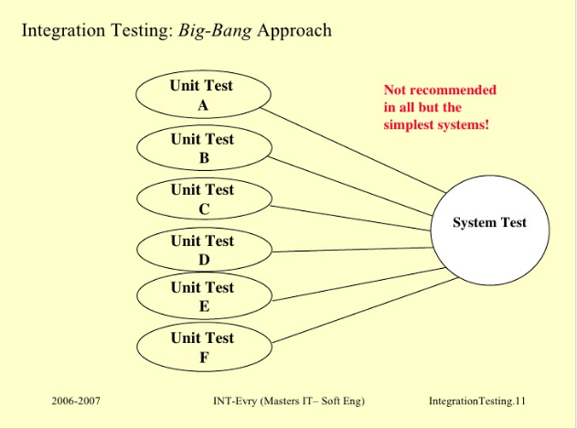

Slide 65
Bottom-up Integration Testing
Integrate and test the bottom level modules first.
A disadvantage of bottom-up testing:
  when the system is made up of a large number of small subsystems.
  This extreme case corresponds to the big bang approach.

Slide 66
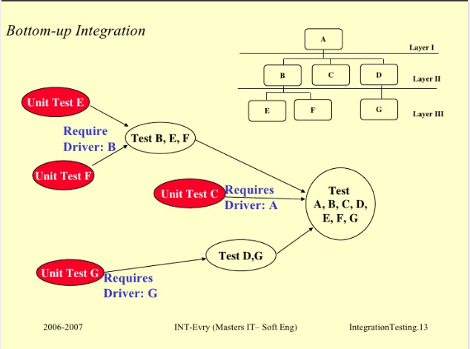

Slide 67
Top-down integration testing
Top-down integration testing starts with the main routine:
  and one or two subordinate routines in the system.
After the top-level 'skeleton’ has been tested:
  immediate subordinate modules of the 'skeleton’ are combined with it and tested.

Slide 68
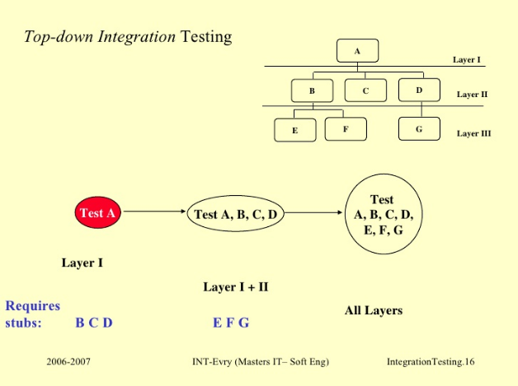

Slide 69
Mixed integration testing
Mixed (or sandwiched) integration testing:
  uses both top-down and bottom-up testing approaches.
  Most common approach

Slide 70
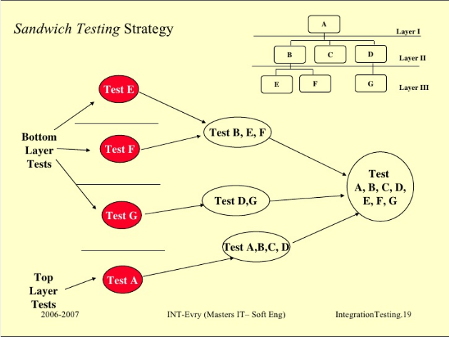

Slide 71
Integration Testing
In top-down approach:
  testing waits till all top-level modules are coded and unit tested.
In bottom-up approach:
  testing can start only after bottom level modules are ready.

Slide 72
Phased versus Incremental Integration Testing
Integration can be incremental or phased.
In incremental integration testing,
  only one new module is added to the partial system each time.

Slide 73
Phased versus Incremental Integration Testing
In phased integration,
  a group of related modules are added to the partially integrated system each time.
Big-bang testing:
  a degenerate case of the phased integration testing.

Slide 74
Phased versus Incremental Integration Testing
Phased integration requires less number of integration steps:
  compared to the incremental integration approach.
However, when failures are detected,
  it is easier to debug if using incremental testing
    since errors are very likely to be in the newly integrated module.

Slide 75
System Testing
There are three main kinds of system testing:
  Alpha Testing
  Beta Testing
  Acceptance Testing

Slide 76
Alpha Testing
System testing is carried out by the test team within the developing organization.

Slide 77
Beta Testing
System testing performed by a select group of friendly customers.

Slide 78
Acceptance Testing
System testing performed by the customer himself:
  to determine whether the system should be accepted or rejected.

Slide 79
System Testing
During system testing, in addition to functional tests:
  performance tests are performed.

Slide 80
Performance Testing
Addresses non-functional requirements.
  May sometimes involve testing hardware and software together.
  There are several categories of performance testing.

Slide 81
Stress testing
Evaluates system performance
  when stressed for short periods of time.
Stress testing
  also known as endurance testing.

Slide 82
Stress testing
Stress tests are black box tests:
  designed to impose a range of abnormal and even illegal input conditions
  so as to stress the capabilities of the software.

Slide 83
Stress Testing
If the requirements is to handle a specified number of users, or devices:
  stress testing evaluates system performance when all users or devices are busy simultaneously.

Slide 84
Stress Testing
If an operating system is supposed to support 15 multiprogrammed jobs,
  the system is stressed by attempting to run 15 or more jobs simultaneously.
A real-time system might be tested
  to determine the effect of simultaneous arrival of several high-priority interrupts.

Slide 85
Volume Testing
Addresses handling large amounts of data in the system:
  whether data structures (e.g. queues, stacks, arrays, etc.) are large enough to handle all possible situations
  Fields, records, and files are stressed to check if their size can accommodate all possible data volumes.

Slide 86
Configuration Testing
Analyze system behavior:
  in various hardware and software configurations specified in the requirements
  sometimes systems are built in various configurations for different users
  for instance, a minimal system may serve a single user,
    other configurations for additional users.

Slide 87
Compatibility Testing
These tests are needed when the system interfaces with other systems:
  check whether the interface functions as required.

Slide 88
Compatibility testing
Example
If a system is to communicate with a large database system to retrieve information:
  a compatibility test examines speed and accuracy of retrieval.

Slide 89
Recovery Testing
These tests check response to:
  presence of faults or to the loss of data, power, devices, or services
  subject system to loss of resources
    check if the system recovers properly.

Slide 90
Maintenance Testing
Verify that:
  all required artifacts for maintenance exist
  they function properly

Slide 91
Documentation tests
Check that required documents exist and are consistent:
  user guides,
  maintenance guides,
  technical documents

Slide 92
Documentation tests
Sometimes requirements specify:
  format and audience of specific documents
  documents are evaluated for compliance

Slide 93
Usability tests
All aspects of user interfaces are tested:
  Display screens
  messages
  report formats
  navigation and selection problems

Slide 94
Regression Testing
Does not belong to either unit test, integration test, or system test.
  In stead, it is a separate dimension to these three forms of testing.

Slide 95
Regression testing
Regression testing is the running of test suite:
  after each change to the system or after each bug fix
  ensures that no new bug has been introduced due to the change or the bug fix.

Slide 96
Regression testing
Regression tests assure:
  the new system’s performance is at least as good as the old system
  always used during phased system development.

Slide 97
How many errors are still remaining?
Seed the code with some known errors:
  artificial errors are introduced into the program.
  Check how many of the seeded errors are detected during testing.

Slide 98
Error Seeding
Let:
  N be the total number of errors in the system
  n of these errors be found by testing.
  S be the total number of seeded errors,
  s of the seeded errors be found during testing.

Slide 99
Error Seeding
n/N = s/S
N = S n/s
remaining defects:
N - n = n ((S - s)/ s)

Slide 100
Example
100 errors were introduced.
90 of these errors were found during testing
50 other errors were also found.
Remaining errors=
50 (100-90)/90 = 6

Slide 101
Error Seeding
The kind of seeded errors should match closely with existing errors:
  However, it is difficult to predict the types of errors that exist.
Categories of remaining errors:
  can be estimated by analyzing historical data from similar projects.

Slide 102
Summary
Exhaustive testing of almost any non-trivial system is impractical.
  we need to design an optimal test suite that would expose as many errors as possible.

Slide 103
Summary
If we select test cases randomly:
  many of the test cases may not add to the significance of the test suite.
There are two approaches to testing:
  black-box testing
  white-box testing.

Slide 104
Summary
Black box testing is also known as functional testing.
Designing black box test cases:
  requires understanding only SRS document
  does not require any knowledge about design and code.
Designing white box testing requires knowledge about design and code.

Slide 105
Summary
We discussed black-box test case design strategies:
  equivalence partitioning
  boundary value analysis
We discussed some important issues in integration and system testing.

